Slide 1


Solar Power
A Presentation by Keshaw Singh

Slide 2

Harnessing the Sun: A Deep Dive into Solar Power
Clean, Renewable Energy for a Sustainable Future
Keshaw Singh
Date: 30 November 2024
Notes:
Harnessing the Sun: A Deep Dive into Solar Power
Clean, Renewable Energy for a Sustainable Future
Keshaw Singh
Date: 30 November 2024

Slide 3
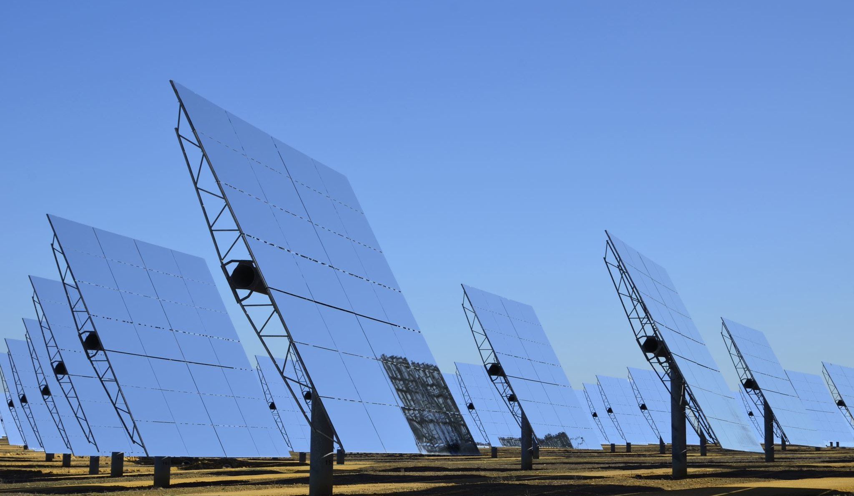
Introduction to Solar Power
What is Solar Power?
Energy derived from the sun's radiation
How Solar Power Works:
Solar panels convert sunlight into electricity
Basic components: solar cells, inverters
Types of Solar Power:
Photovoltaic (PV) solar power
Solar thermal power
Benefits of Solar Power:
Clean and renewable energy source
Reduced carbon emissions
Energy independence
Notes:
Introduction to Solar Power
What is Solar Power?
Energy derived from the sun's radiation
How Solar Power Works:
Solar panels convert sunlight into electricity
Basic components: solar cells, inverters
Types of Solar Power:
Photovoltaic (PV) solar power
Solar thermal power
Benefits of Solar Power:
Clean and renewable energy source
Reduced carbon emissions
Energy independence

Slide 4
The Science Behind Solar Power
Photovoltaic Effect:
How sunlight interacts with solar cells
Generation of electric current
Solar Cell Technology:
Different types of solar cells (crystalline silicon, thin-film, etc.)
Efficiency and cost considerations
Notes:
Photovoltaic Effect:
Solar Cell Technology:

Slide 5

Solar Power Systems
On-Grid Systems:
Connected to the utility grid
Off-Grid Systems:
Independent power systems
Hybrid Systems:
Combination of on-grid and off-grid systems
Excess energy can be sold back to the grid
Ideal for remote locations
Notes:
On-Grid Systems:
Connected to the utility grid
Excess energy can be sold back to the grid
Off-Grid Systems:
Independent power systems
Ideal for remote locations
Hybrid Systems:
Combination of on-grid and off-grid systems

Slide 6
Advantages of Solar Power
Environmental Benefits:
Reduced greenhouse gas emissions
Reduced air and water pollution
Economic Benefits:
Lower electricity bills
Job creation
Energy Security:
Reduced dependence on fossil fuels
Notes:
Environmental Benefits:
Reduced greenhouse gas emissions
Reduced air and water pollution
Economic Benefits:
Lower electricity bills
Job creation
Energy Security:
Reduced dependence on fossil fuels

Slide 7
Slide 6: Challenges and Limitations
Initial Investment Cost:
High upfront costs for solar panel installation
Intermittency:
Solar power generation depends on sunlight availability
Weather Dependence:
Cloudy or rainy weather can reduce power output
Land Use:
Large-scale solar power plants require significant land area
Notes:
Initial Investment Cost:
High upfront costs for solar panel installation
Intermittency:
Solar power generation depends on sunlight availability
Weather Dependence:
Cloudy or rainy weather can reduce power output
Land Use:
Large-scale solar power plants require significant land area

Slide 8
Government Policies and Incentives
Net Metering:
Policy that allows homeowners to sell excess solar power to the utility grid
Tax Credits and Rebates:
Government incentives to promote solar energy adoption
Feed-in Tariffs:
Guaranteed price for electricity generated from renewable sources
Notes:
Net Metering:
Policy that allows homeowners to sell excess solar power to the utility grid
Tax Credits and Rebates:
Government incentives to promote solar energy adoption
Feed-in Tariffs:
Guaranteed price for electricity generated from renewable sources

Slide 9
Future of Solar Power
echnological Advancements:
Increased efficiency and lower costs
New solar technologies (e.g., perovskite solar cells)
Integration with Other Renewable Sources:
Hybrid systems for reliable and sustainable energy
Role of Solar Power in a Sustainable Future:
Decarbonization of the energy sector
Addressing climate change
Notes:
echnological Advancements:
Increased efficiency and lower costs
New solar technologies (e.g., perovskite solar cells)
Integration with Other Renewable Sources:
Hybrid systems for reliable and sustainable energy
Role of Solar Power in a Sustainable Future:
Decarbonization of the energy sector
Addressing climate change

Slide 10
Case Studies: Successful Solar Power Projects
Large-Scale Solar Farms:
Examples of successful solar power projects around the world
Community Solar Projects:
Empowering communities through shared solar ownership
Residential Solar Installations:
Benefits for homeowners and the environment
Notes:
Large-Scale Solar Farms:
Examples of successful solar power projects around the world
Community Solar Projects:
Empowering communities through shared solar ownership
Residential Solar Installations:
Benefits for homeowners and the environment

Slide 11
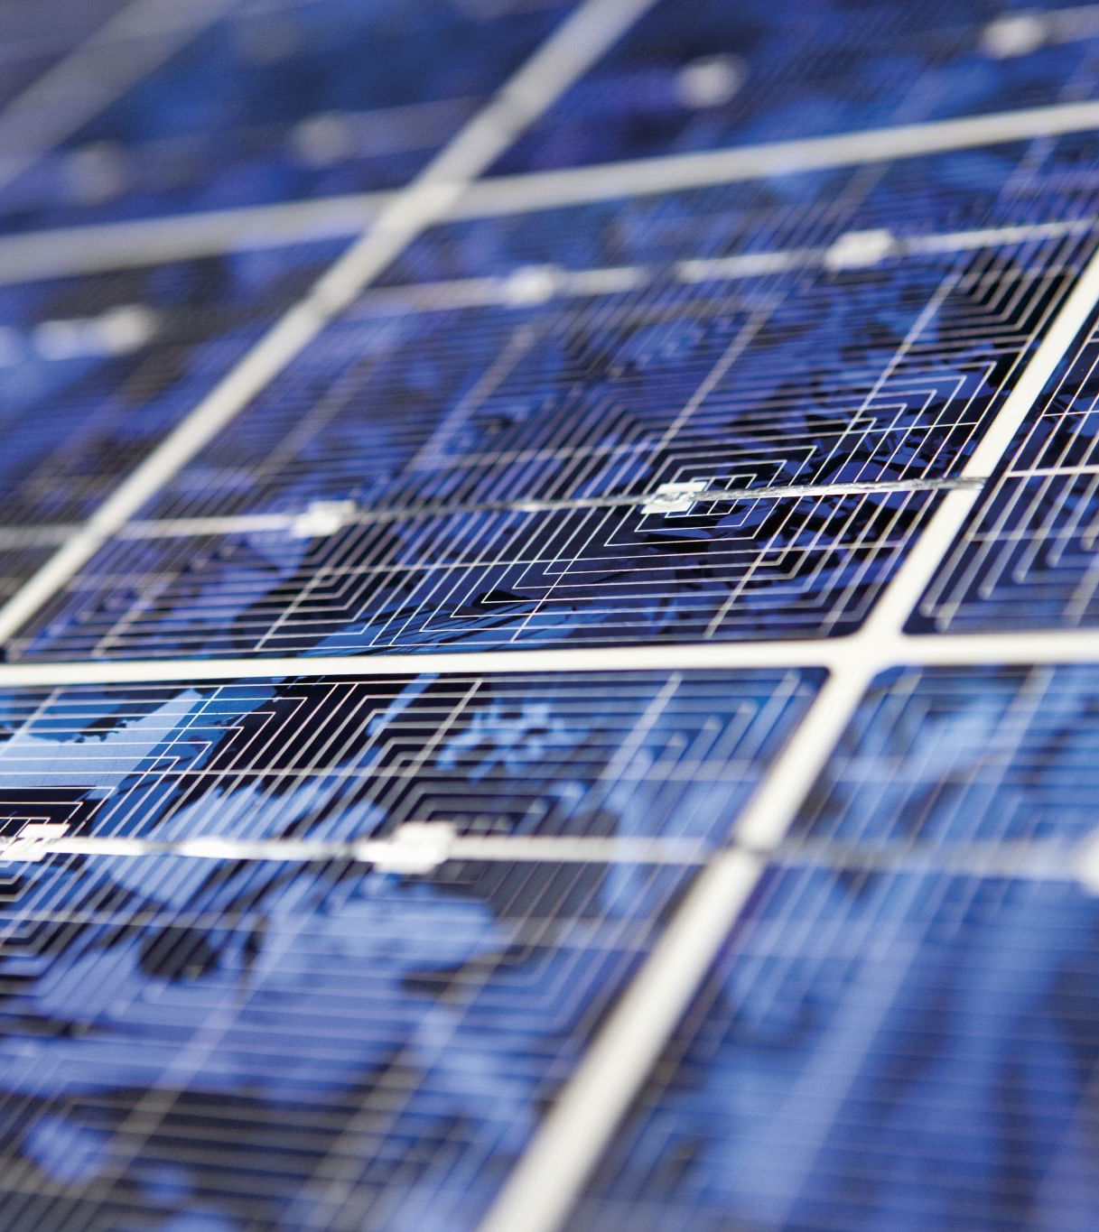
DIY Solar Power: A Beginner's Guide
Basic Components:
Solar panels, inverter, charge controller, batteries
Installation Tips:
Factors to consider: sunlight exposure, roof orientation, local regulations
Maintenance Tips:
Regular cleaning, monitoring, and troubleshooting
Notes:
Basic Components:
Solar panels, inverter, charge controller, batteries
Installation Tips:
Factors to consider: sunlight exposure, roof orientation, local regulations
Maintenance Tips:
Regular cleaning, monitoring, and troubleshooting

Slide 12

Conclusion
Recap of Key Points:
Environmental benefits, economic advantages, and technological advancements
Call to Action:
Encourage audience to consider solar power for their homes or businesses
Promote sustainable energy practices
Notes:
Recap of Key Points:
Environmental benefits, economic advantages, and technological advancements
Call to Action:
Encourage audience to consider solar power for their homes or businesses
Promote sustainable energy practices

Slide 13
Q&A Session
Open the floor for questions and discussions
Notes:
Open the floor for questions and discussions

